Slide 1
Exploratory Data Analysis
By
Rashmi.K
INSAID

Slide 2
Agenda
Problem Statement
Conclusion
Python Analysis

Slide 3
Google Play Store Data Analysis: Hypothesis
Problem Statement:
Types of app to be launched by google play store to be successful.
Hypothesis:
Highest installed apps will get more reviews

Slide 4
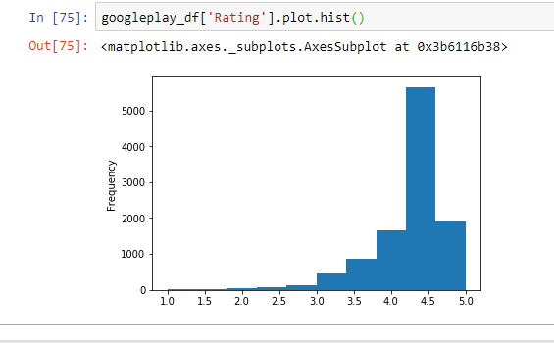
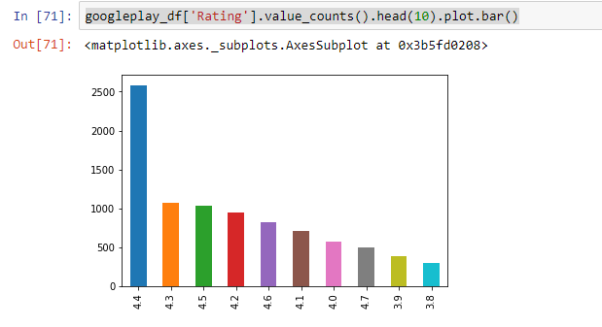
Google Play Store- Rating Analysis

Slide 5
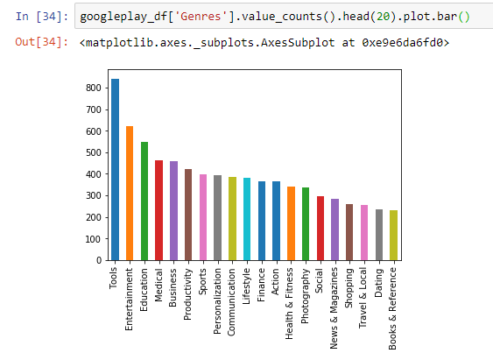
Google Play Store- Genres Analysis

Slide 6
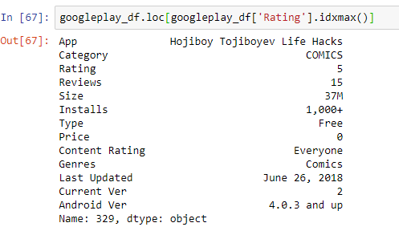
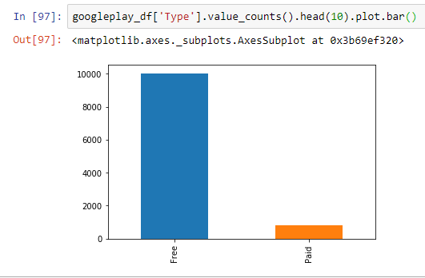
Google Play Store- Type of Apps Analysis

Slide 7
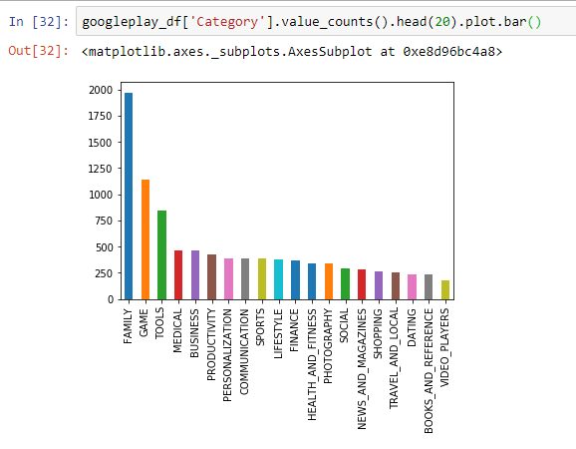
Google Play Store- Category Analysis

Slide 8
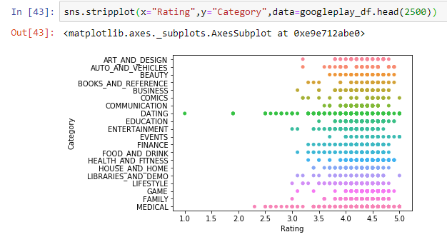
Google Play Store- Rating Analysis

Slide 9
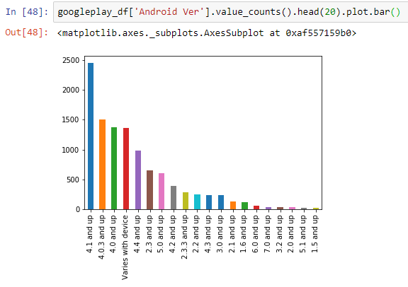
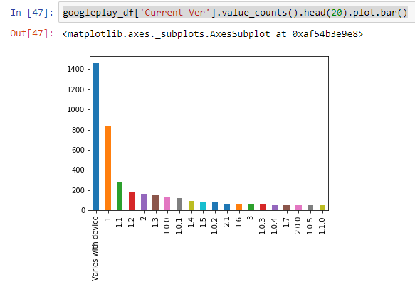
Google Play Store- Version Analysis

Slide 10
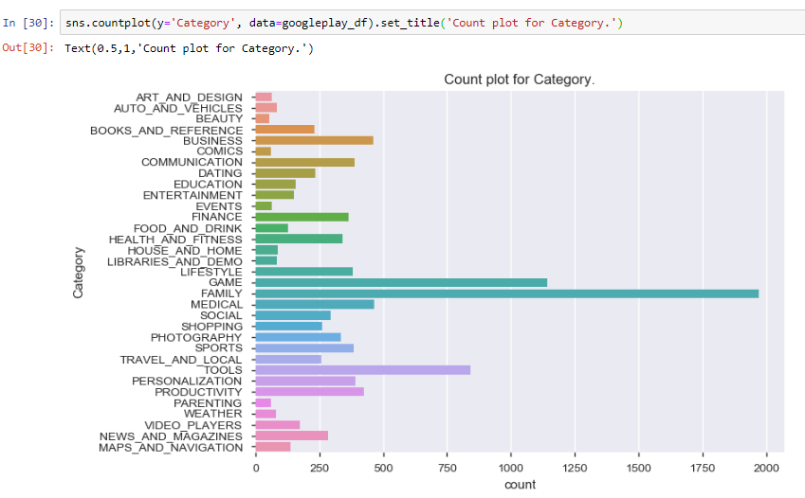
Google Play Store- Category Analysis

Slide 11
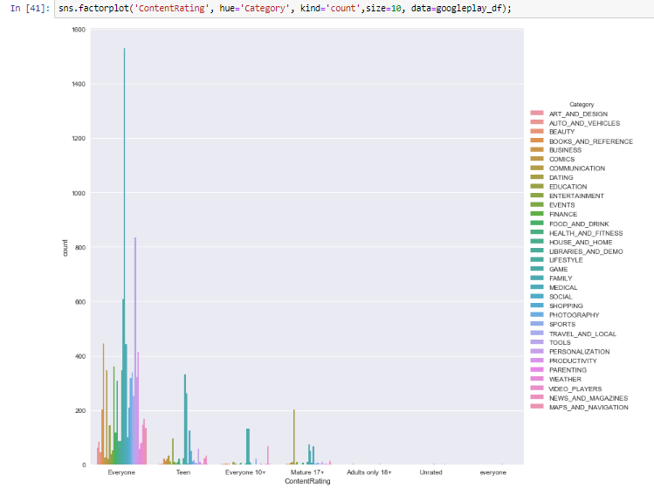
Google Play Store- Content Rating Analysis

Slide 12
Observations:
Category family has more number of apps.
Even though Game category apps are lesser in counts compared to family category, it is mostly downloaded category in android playstore market.
Rating of the apps in the game category is mostly above 4.0.
Most of the apps in the playstore are designed for every age groups. Interestingly, there are very few adult apps based on this dataset.
Device running with minimum android version 4.1 will have more number of apps for it in the playstore. Even it has more games.
Higher sized apps are downloaded most than lower sized apps. Because games are downloaded most which is obviously has higher sizes.
Most apps can be downloaded free of cost.
Most installed apps have most reviews.
Category Game has most installed since most installed apps likely to get more reviews. Henceforth if app related to game is launched in the market, it will be more likely to be successful.
Machine learning model can be applied to predict app rating, reviews.

Slide 13
THANK YOU

